Slide 1
Machine Learning in Fighting Games
By: Jay Bishop, Jordan Cooper, Brant Dolling, and Kegan McIlwaine

Slide 2
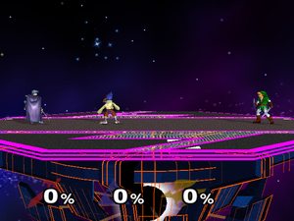
Super Smash Brothers Melee (SSBM)
Fighting game for the Nintendo GameCube
Players try to eliminate each other by knocking opponents off the stage
Damage to players is measured in a percentage that increases as damage is sustained
The higher a player’s percentage, the further an attack against them will propel them

Slide 3
Problem
Players of this game need to train to improve their skills
It is difficult to find a good training partner
Playing against the built in bots does not adequately prepare an individual for play against other humans
The built in AI does not use any highly technical moves
The built in AI acts in a very predictable manner
The built in AI does not improve

Slide 4
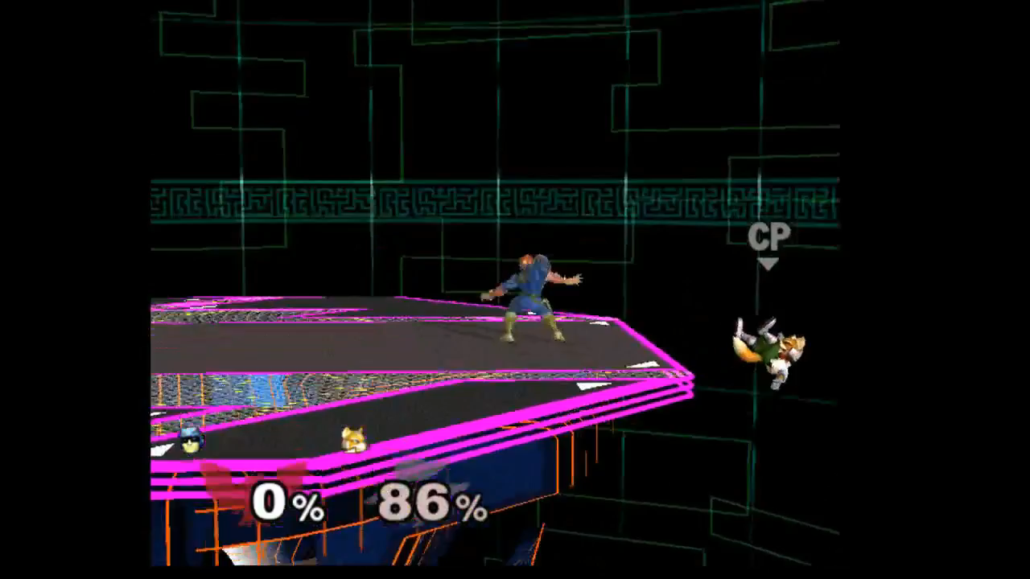

Slide 5
Our Solution
Give the players a better AI to train against
Implement a reinforcement learning algorithm that will learn to play better than the players

Slide 6
Asynchronous Advantage Actor-Critic (A3C)
A3C is a reinforcement learning algorithm
There is one global neural network
Each character controlled by our program has a local neural network
Before training, the global network is copied to all local networks
When updates are calculated for a character’s network, the updates are applied to the global network
The global network is then copied to the local network and training continues

Slide 7
Details of Our Program
Named pipes are used to send controller commands to the emulator
The memory watcher included in the emulator is used to get RAM information
Our program preprocesses the RAM, runs the neural network, and outputs to the named pipes

Slide 8
Training
Area in which the most problems we had arose
Difficult to debug
Had to reset our training on multiple occasions
Can lead to overfitting if done incorrectly
Began training our bot against a single in-game level 5 opponent
Ended up using A3C’s shared network to speed up training by having two teams of two bots training with each other constantly.

Slide 9
Reward System
Used to let the bot know how it is doing
Bot awarded a point for each time an opponent dies; Loses a point for dying
Bot is awarded 0.01 points for each percent of damage inflicted on opponents and loses 0.01 for each percent of damage it takes
Bot also loses points at a reduced rate (20%) for their allies dying or sustaining damage

Slide 10
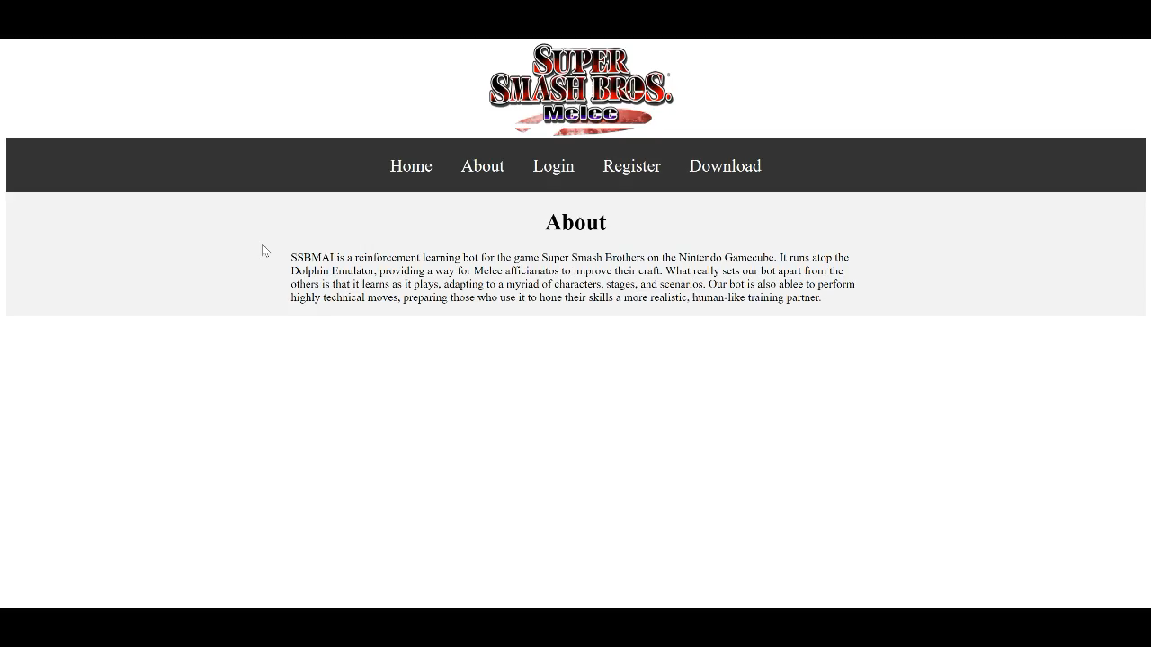

Slide 11
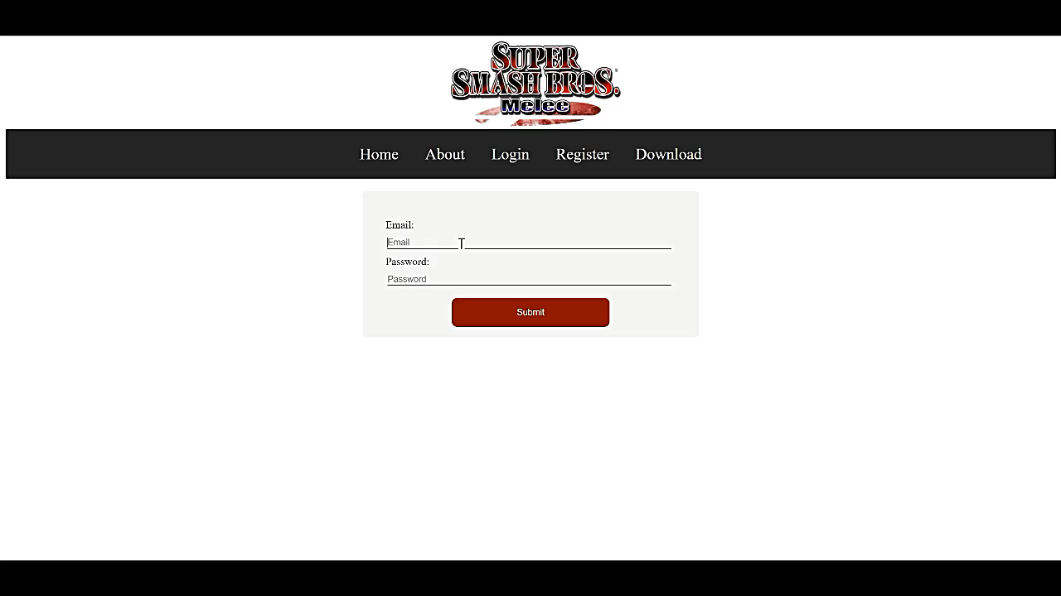

Slide 12
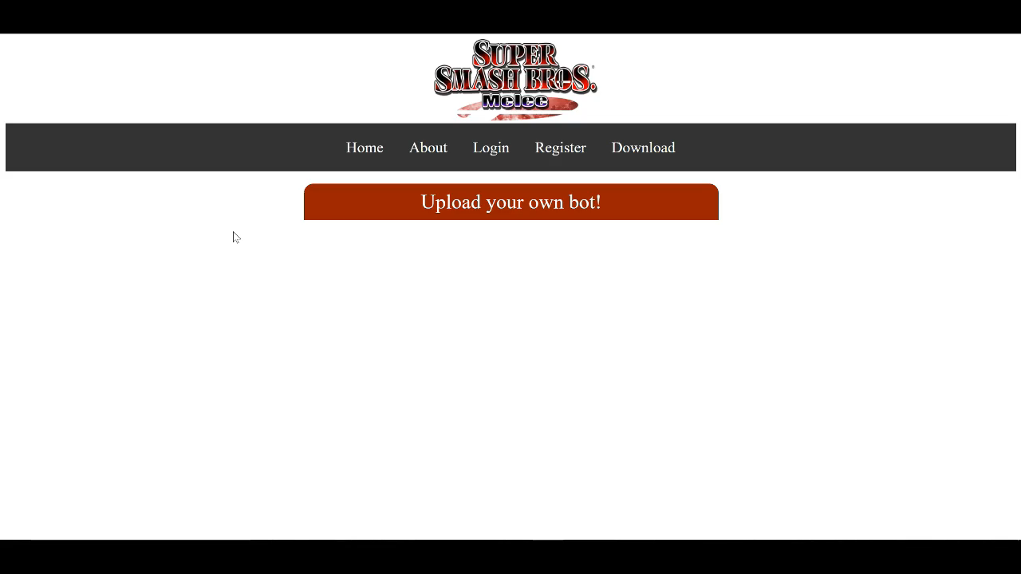

Slide 13
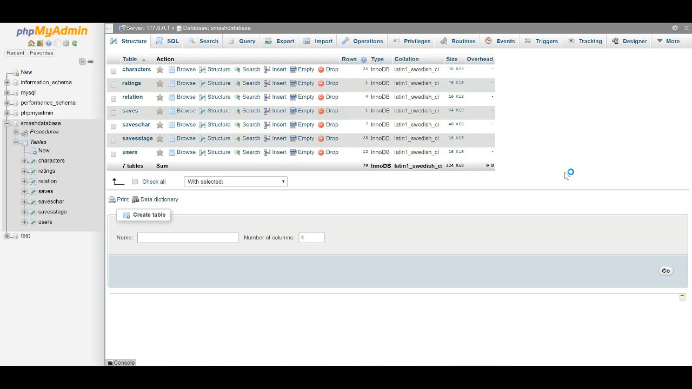

Slide 14
PyQT – GUI
Tkinter look and feel
Launch the bot
Multiplayer selection
Train a bot

Slide 15
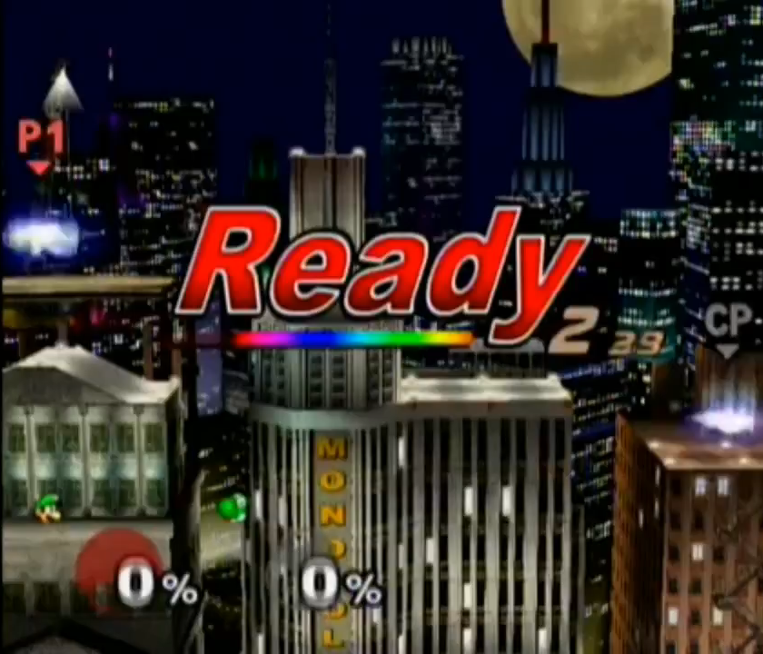
Applications
Play against machine learning bots
CPU bots can be too easy
Already existing bots can be easily exploited
Help players improve their play
Neural network can be applied to other games
Retrain on other games
Create new reward system

